Slide 1


EnronOnline
Phase II
Report Date- July 21, 2000
Confidential

Slide 2
EnronOnline
Project Objective:
The scope of our review is designed to understand and identify key control mechanisms within the global EnronOnline environment related to the completeness and accuracy of transaction data transfer, management reporting and exposure monitoring. Our audit procedures included interviews with IT Compliance group personnel, review of IT Compliance testing and a test of customer transactions.
AA Team Members: Enron Team Members:
Tom Bauer Andrew Parsons
Jennifer Stevenson Mark Thibodeaux
Michael Schultz Sheri Thomas
Cindy Davis
Russ Bouwhuis
Sharon Smith

Slide 3
EnronOnline Facts
Facts as of 6/12/00
EnronOnline trading currently occurs in Houston, Portland, Calgary, Sydney, London, Oslo, and Singapore
An average of 1,900 external deals are transacted daily with approximately 7% representing new customers
Gross notional value of transactions is approximately $66 billion
*DEAL TEST - Tested 32 North America deals and 9 international deals

Slide 4
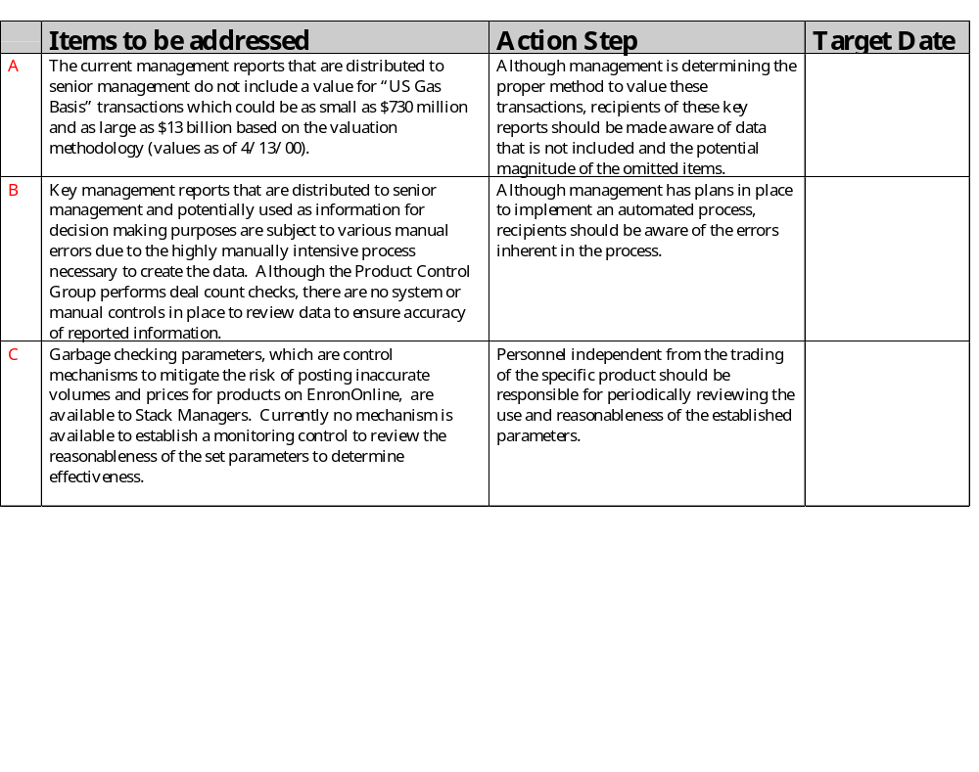
EnronOnline Observations

Slide 5
EnronOnline
Deal Test Results
Key attributes tested
Deal terms in appropriate capture system
Deal terms in capture system agree to EnronOnline
Deal valued accurately
Customer approved for trading
Executed written confirmation
Appropriate reference to contract in confirmation
Appropriate executed Master Agreement or GTC
Summary of test findings
Inaccurate contract data in EnronOnline for 1 transaction (Chase- EnronOnline references a GTC when Master Agreement exists)
7 transactions do not have executed written confirmations - 6 Domestic and 1 International (Non EnronOnline process issue)
Conclusion
All tested transactions were accurately reflected in the capture systems

Slide 6

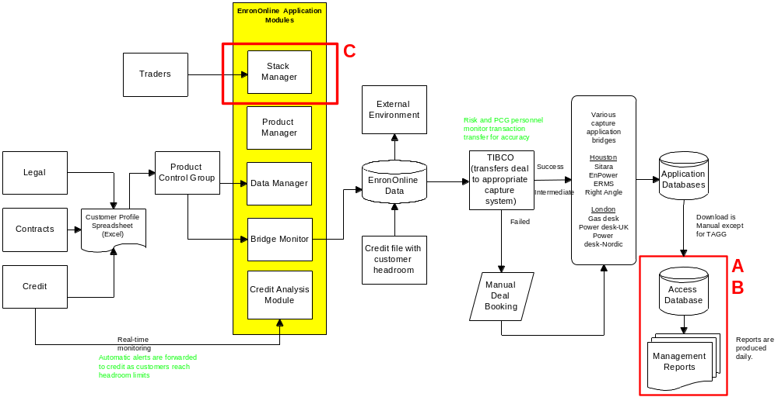
EnronOnline

